Slide 1


A Recurrent Neural Network for Non-Linear Control of a Fixed-Wing UAV
Ohanes Dadian and Subdoh Bhandari
Cal Poly Pomona
American Control Conference, 2016
<number>
6/28/16

Slide 2

Topics
UAV Lab
Research Objectives
Motivation
Artificial Neural Networks
Echo State Networks
Prototype
Implementation
Results
Conclusion
Future Work
Q & A
<number>
6/28/16

Slide 3
CPP UAV Lab
The Unmanned Aerial Vehicles (UAV) Lab at Cal Poly Pomona (CPP) hosts a fleet of 15 airplanes, helicopters, and quadcopters.
The aircraft are used to aid in research on advanced aerospace topics.
Such as flight dynamics and control.
Current focused on increased UAV autonomy.
Collision and obstacle avoidance
Intelligent control
Multi-vehicular control
Collaboration between multiple unmanned vehicles (UAVs and UGVs)
Navigation in GPS-denied environment
<number>
6/28/16

Slide 4
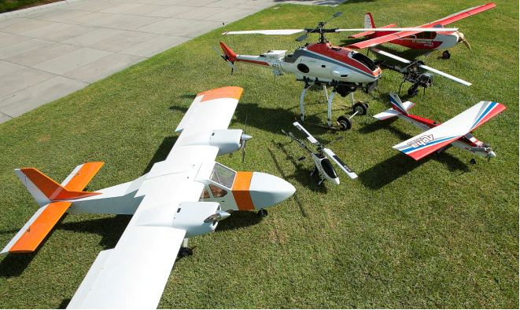
Cal Poly Pomona UAV Fleet
Over 15 airplanes, heli- and multi-copters.
12 Foot Telemaster
Yamaha RMAX
Alpha 60
Raptor 90
Twin Engine
<number>
7/3/16
Notes:
<number>

Slide 5
Research Objectives
Develop Neural Network based non-linear controllers for Unmanned Aerial Vehicles (UAVs).
Models of Feed Forward and Recurrent classifications.
A Recurrent model will allow for closer adherence to control laws.
Provide a feedback loop, allowing for adaptive control.
Validation & Verification is performed in software-in-the-loop and hardware-in-the-loop environments.
Integrate controller into open source platform UAV fleet.
Provide non-linear adaptive control to system.
<number>
6/28/16

Slide 6
Motivation
Widespread use of UAVs requires
Increased autonomy
Ability to fly autonomously in the wide range of flight envelope (changes in speed and altitude, parameter variation)
Gain scheduling is a popular means of accomplishing this goal
Computationally Expensive
High Design and Implementation Costs
Rapid changes in gains lead to instability
Pre-computed predictions may lead to vehicle failure
<number>
6/28/16

Slide 7
Motivation (Contd.)
Implementation of non-linear controllers requires detailed and accurate knowledge of flight dynamics and is computationally intensive
Dynamic Inversion
Neural nets can overcome these shortcomings
Provide a connectionist and non-linear approach to solving computational problems
<number>
6/28/16

Slide 8
Artificial Neural Networks
Biological inspiration
Artificial neurons used as building block
Emits 0 or 1 (synapse fire)
A series of neurons are interconnected to create neural layers
Layers of neurons used to perform common task
Logical OR's and AND's to combine neurons
Neuron state of first layer is computed first.
Following layer's neuron states based on previous layers.
Hidden layers provide nonlinear transformation
Hard threshold transforms into soft threshold
Easier to break problem up in nonlinear space.
Layers of neurons connected to form neural net.
<number>
6/28/16

Slide 9
Artificial Neural Networks, contd.
Connections between neurons are weighted.
Weights of connections provide ability to find most fitted models.
Follow path to least cost.
Neural Networks are trained using a learning algorithm.
Uses training data which labels are acceptable and unacceptable.
Mean Square Error (MSE) used to determine if the model is fitted.
Compute deltas of weighted neuron state and output signal against teacher signal.
Determine deltas of last layer first.
Recurse through network to determine previous deltas.
<number>
6/28/16

Slide 10
Artificial Neural Networks (Contd.)
Neural Nets can be used to map complex relationships between inputs and outputs or perform pattern recognition
Program computer to learn how to learn
Virtually any function can be approximated using input-output pairs.
No assumptions required.
Adaptive nature allows for response to unexpected inputs and patterns.
Comes in many forms.
Feed-forward
Recurrent
<number>
6/28/16

Slide 11
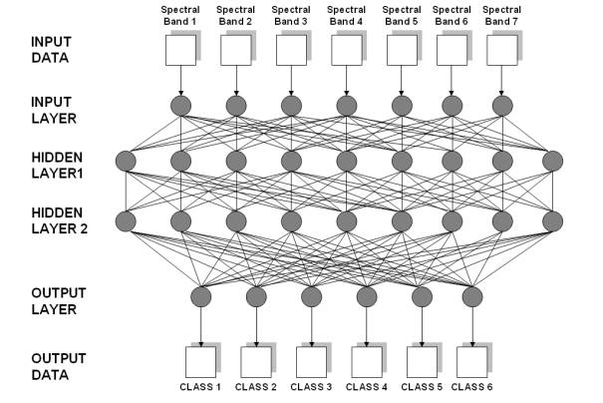
Neural Network Layers
<number>
7/3/16

Slide 12
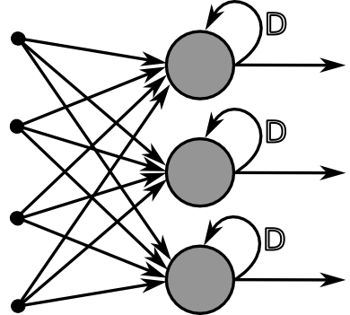
Recurrent Neural Networks
All connections form a directed cycle.
<number>
6/28/16
Notes:
<number>

Slide 13
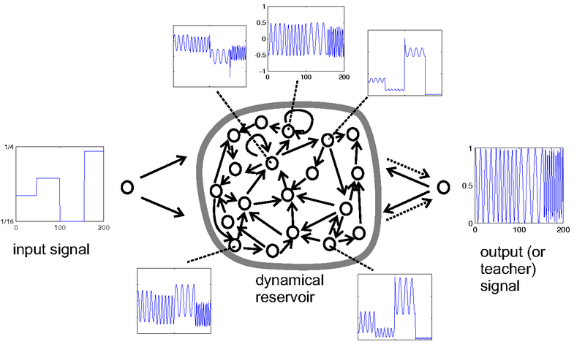
Echo State Network
Provide current knowledge with simpler implementation.
Sparsely connected neurons.
Weights are fixed.
Hidden layer behaves as a reservoir.
Implements a leak rate for current knowledge.
<number>
6/28/16

Slide 14
ESN Algorithm
Generate a large random reservoir.
Train using input data and collect corresponding reservoir activation states.
Nonlinear transform of input signal (square wave) and the output signal (sine wave).
Simple design and implementation.
Short-term memory aids in enhancing learning process.
Compute the linear readout weights from the reservoir and using linear regression (Weiner-Hopf method).
Compute Mean Square Error (MSE).
Retrain if MSE is too high.
<number>
6/28/16

Slide 15
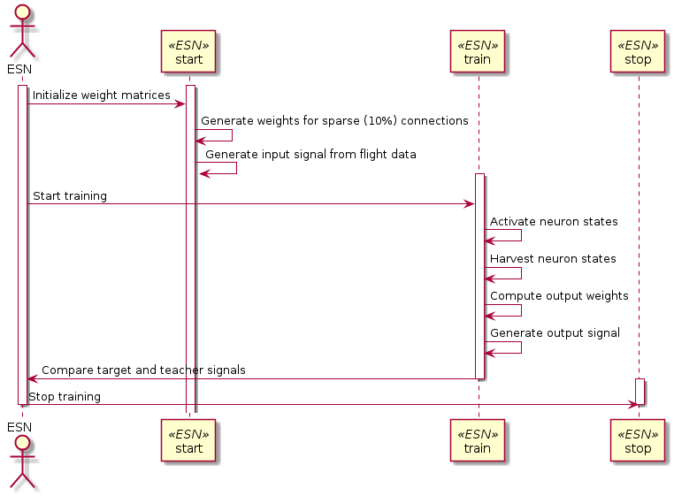
ESN Training Sequence
<number>
7/3/16

Slide 16
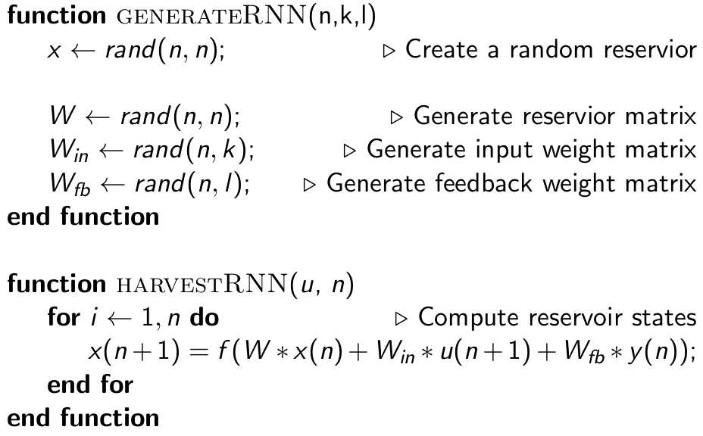
ESN Algorithm, contd.
<number>
6/28/16

Slide 17
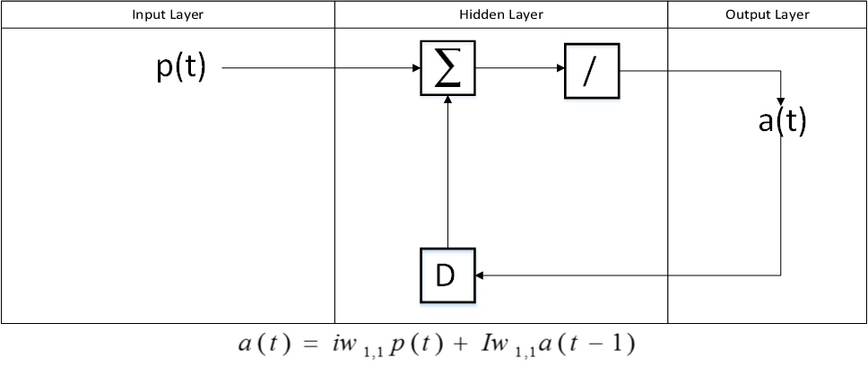
Reservoir (Hidden Layer)
The memory in the hidden layer as a state space
The neurons make up the state, charged by the time delay propagation of output neurons
Effects of the environment are applied to the model through the input sources

Slide 18
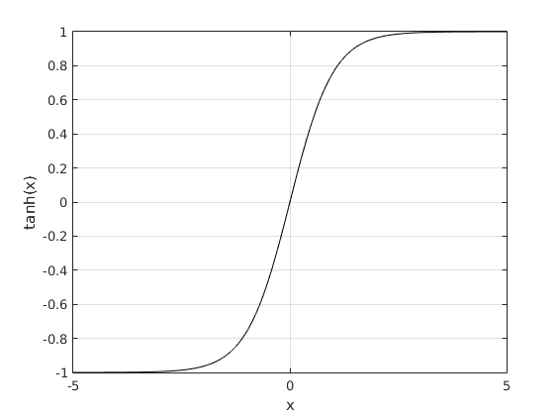
Activation Function
ESN activates its neurons using Hyperbolic tangent function
<number>
6/28/16
Notes:
<number>

Slide 19
ESN for Control and Identification
Simple Design and Implementation.
Can easily map linear systems to nonlinear form.
Nonlinear transform of input signal and to output signal.
Short-term memory aids in enhancing learning process.
Compute Mean Square Error (MSE).
Retrain if MSE is too high.
<number>
6/28/16

Slide 20
Prototype
MATLAB 2014b
30 neurons
40% leak rate
D matrix generated from Rapter50 helicopter data.
Roll, Pitch, Raw
<number>
6/28/16

Slide 21
Implementation
C++
15 neurons
Eigen
Modified matrix and vector classes to include pseudo-inverse computation.
D matrix generated from TwinEngine Flight Dynamics Model.
Roll, Pitch, Raw
FDM runs in FlightGear.
Roll, Pitch, and Yaw
<number>
6/28/16

Slide 22
Implementation
C++
Eigen
Modified matrix and vector classes to include pseudo-inverse computation.
D matrix generated from TwinEngine Flight Dynamics Model.
Roll, Pitch, Raw
FDM runs in FlightGear.
Roll, Pitch, and Yaw
<number>
6/28/16

Slide 23
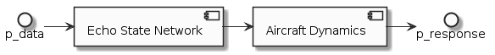
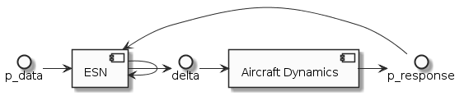
Implementation (Contd.)
Implementation of Offline Model
Implementation of Online Model
<number>
6/28/16
Notes:
<number>

Slide 24
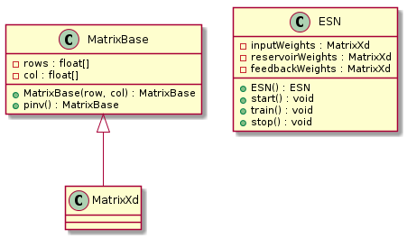
Implementation (Contd.)
<number>
6/28/16
Notes:
<number>

Slide 25
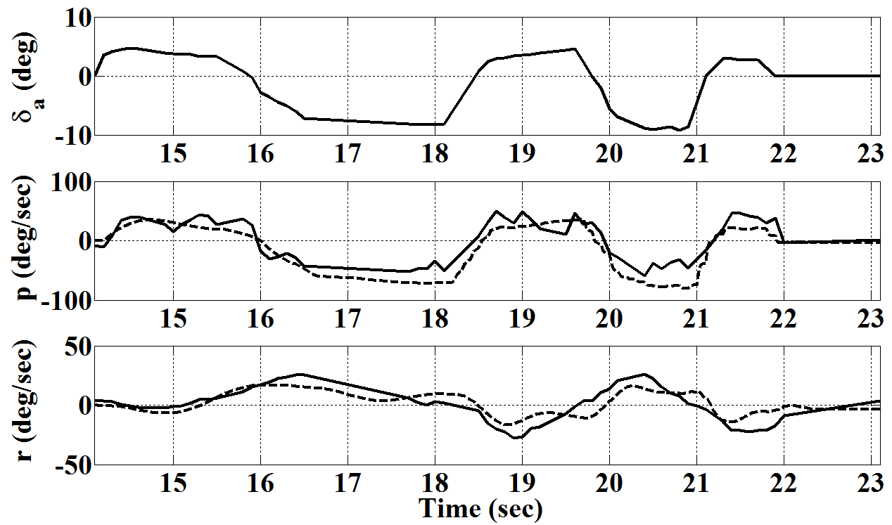
Nonlinear Model Validation
Model developed using Athena Vortex Lattice (AVL), Advanced Aircraft Analysis (AAA), and System identification techniqeus
Flight Data (solid) vs. Model Response for Roll and Yaw Rates
<number>
6/28/16

Slide 26
Aircraft Non-Linear Equations
β, p, r are sideslip angle, roll rate, and yaw rate, respectively
c_{1,} c_{2,} etc. are functions of moments of inertia
The equations are written in terms of stability and control derivatives:
, , , etc.
<number>
6/28/16
Notes:
<number>

Slide 27
Feedback Linearization
General nonlinear equation can be written in the form:
A linearizing controller can be defined as
Off-line trained neural network can be used to represent this inversion
<number>
6/28/16
Notes:
<number>

Slide 28
Network Training
Validated flight dynamics model for of the UAV was used to generate input-output data
This simulated data (roll, pitch, yaw) was then used for train the ANN using ESN (off-line training)
On-line training was then performed to correct for the inversion errors
Data required for the on-line training was obtained from FlightGear model of the aircraft in software-in-the-loop simulation
MATLAB was used initially, but ported to C++
Modified matrix and vector classes to include pseudo-inverse computation.
<number>
6/28/16
Notes:
<number>

Slide 29
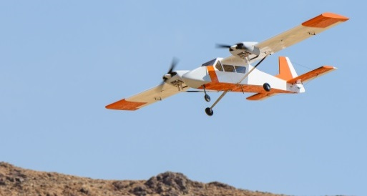
Twin-Engine UAV
Wingspan- 134 inches
Length- 95 inches
Empty weight- 25 lbs
Payload- 15 lbs
<number>
6/28/16

Slide 30
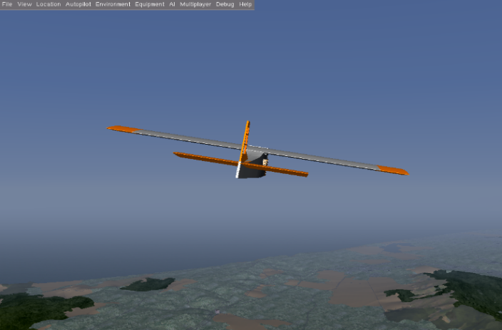
FDM in FlightGear
<number>
6/28/16
Notes:
<number>

Slide 31
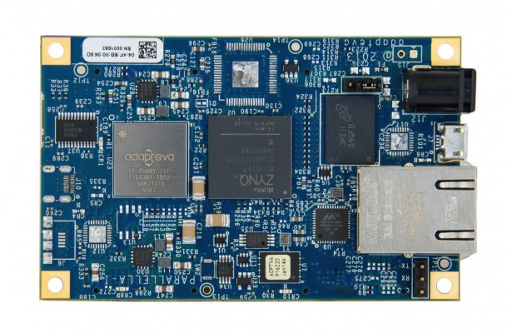
Cal Poly Pomona UAV Fleet
16-core Epiphany RISC SOC
Zynq SOC (FPGA + ARM A9)
Gigabit Ethernet
1GB SDRAM.
Micro-SD storage.
Up to 48 GPIO pins
<number>
7/3/16
Notes:
<number>

Slide 32
Platform (Contd.)
1 neuron/thread. 1 thread/core.
Thread 2 | Compute Neuron 1
Thread 3 | Compute Neuron 2
... | ...
Thread 16 | Compute Neuron 15
Thread 1 | Model
<number>
6/28/16

Slide 33
Results
The recurrent model was trained with the data obtained from validated flight dynamics model.
Compared the simulated data with the neural network estimation.
Used the UAV flight data for comparison.
Compared the neural network approximation with the flight data for aileron and roll rate responses.
<number>
6/28/16

Slide 34
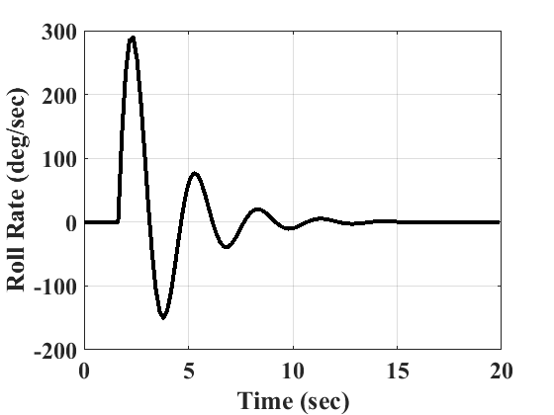
Simulated Roll Rate Used for the Training
<number>
6/28/16
Notes:
<number>

Slide 35
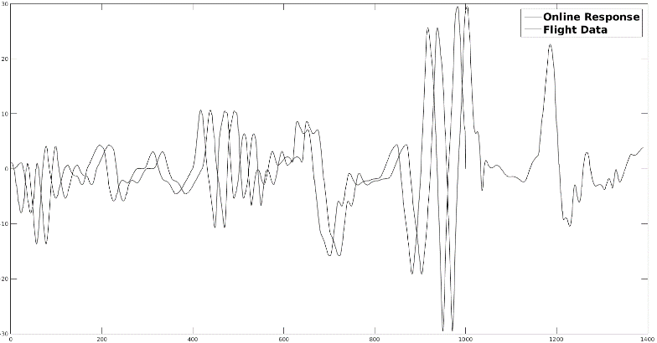
ESN Online Model vs. Sim
<number>
6/28/16
Notes:
<number>

Slide 36
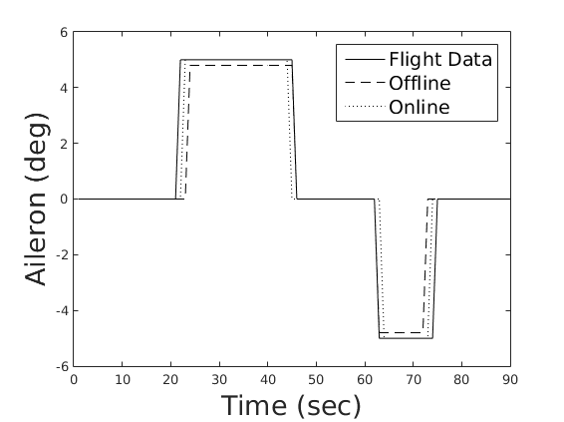
ESN Model Responses vs. Simulated Flight Data
<number>
6/28/16
Notes:
<number>

Slide 37
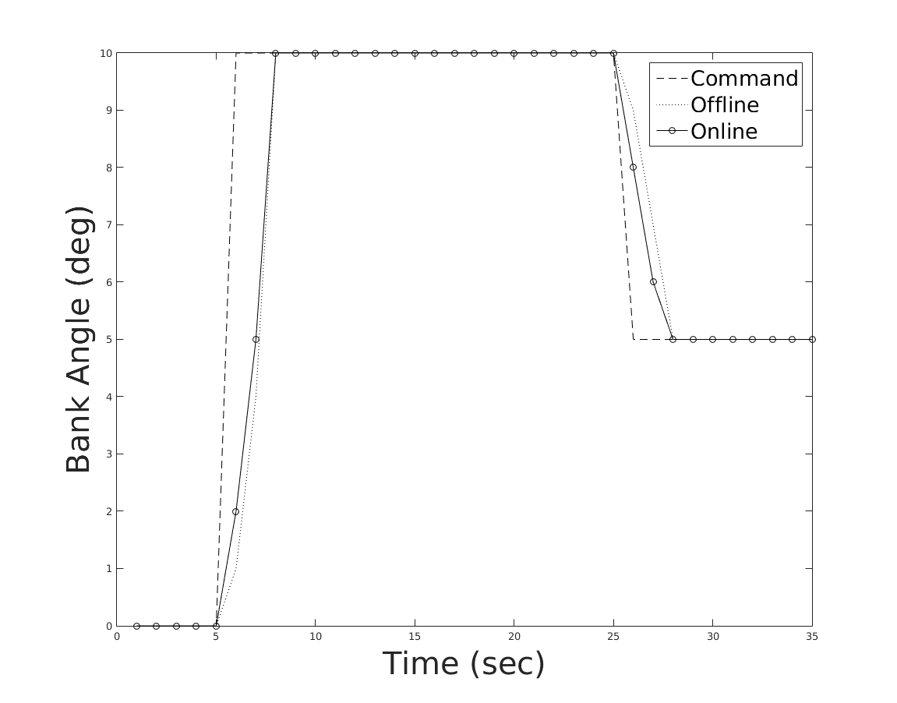
Closed-loop Response for Bank Angle
<number>
6/28/16
Notes:
<number>

Slide 38
Conclusions
ESN can successfully perform identification and nonlinear control of UAVs.
Able to perform both offline and online learning.
Offline training allows for inversion of feedback linearization to be computed.
Simulation showed controller performance significantly improved in both open and closed loop responses.
ESN facilitated adaptability with more ease than a feed forward network.
Able to decrease delta of MSE with less training iterations.
Shorter bursts and Lyapunov sable.
<number>
6/28/16

Slide 39
Future Work
Dynamics model refinement
Further training with simulated and flight data
More on-line training to reduce
Off-line inversion error
Effect of unmodeled dynamics
Effect of disturbances such as vertical gust
Analyze the closed-loop stability using Lyapunov theory
Test controllers in Software-in-the-Loop and Hardware-in-the-Loop simulations
Flight testing
<number>
6/28/16

Slide 40
Acknowledgements
National Science Foundation (Award #1102382)
Hovig Yaralian and Matthew Rose for flight testing, data collection, and data processing
Nigam Patel and Luis Andrade for flight dynamics model development and verification
<number>
6/28/16

Slide 41
Q & A
<number>
6/28/16

